Slide 1
Pipeline for automating builds&deployment
Jenkins , GitHub , maven, SonarQube, docker, owasp dependency

Slide 2
Jenkins
Jenkins is an open source automation server.
It helps automate the parts of software development related to building, testing, and deploying, facilitating continuous integration, and continuous delivery.
It is a server-based system that runs in servlet containers such as Apache Tomcat.
It supports version control tools like Git,, and can execute Apache Maven, and sbt based projects as well as arbitrary shell scripts .
It can be integrated with SonarQube , GitHub, OWASP dependency check , docker , kubernetes.
We have to install plugins according to the integration.
UI is user friendly
Easily manageable
Easily add a node for building jobs
No two stages have same name

Slide 3
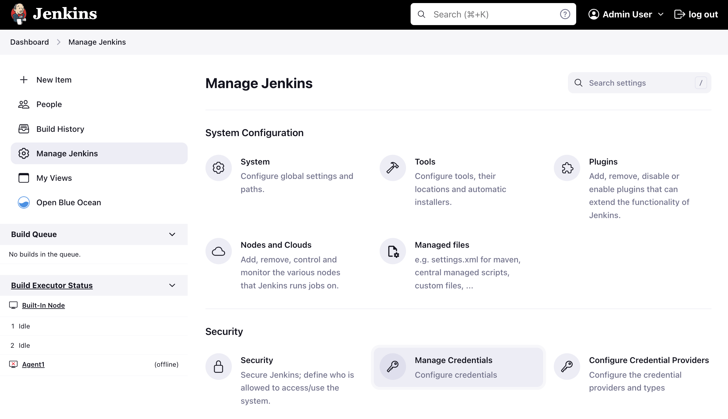
Jenkins installation
installing java
sudo apt update -y
sudo apt install openjdk-11-jre –y
installing JENKINS
sudo wget https://updates.jenkins.io/download/war/2.387.3/jenkins.war

Slide 4
DOcker
Docker is a set of platform as a service (PaaS) products that use OS-level virtualization to deliver software in packages called containers.
The service has both free and premium tiers. The software that hosts the containers is called Docker Engine.
It was first released in 2013 and is developed by Docker, Inc.
Docker is a tool that is used to automate the deployment of applications in lightweight containers so that applications can work efficiently in different environments in isolation.
DockerFile: contains the commands to package the application with envinorment(FROM,COPY,EXPOSE,CMD).

Slide 5
Docker installation
sudo apt-get update
sudo apt-get install ca-certificates curl gnupg
sudo install -m 0755 -d /etc/apt/keyrings
curl -fsSL https://download.docker.com/linux/ubuntu/gpg | sudo gpg --dearmor -o /etc/apt/keyrings/docker.gpg
sudo chmod a+r /etc/apt/keyrings/docker.gpg
echo \
"deb [arch="$(dpkg --print-architecture)" signed-by=/etc/apt/keyrings/docker.gpg] https://download.docker.com/linux/ubuntu \
"$(. /etc/os-release && echo "$VERSION_CODENAME")" stable" | \
sudo tee /etc/apt/sources.list.d/docker.list > /dev/null
. sudo apt-get update
sudo apt-get install docker-ce docker-ce-cli containerd.io docker-buildx-plugin docker-compose-plugin
sudo apt install docker-compose
service docker restart
sudo usermod -aG docker $USER
newgrp docker
sudo chmod 666 /var/run/docker.sock
sudo systemctl restart docker

Slide 6
sonarqube
SonarQube (formerly Sonar) is an open-source platform developed by Sonar Source for continuous inspection of code quality to perform automatic reviews with static analysis of code to detect bugs and code smells on 29 programming languages.
SonarQube offers reports on duplicated code, coding standards, unit tests, code coverage, code complexity, comments, bugs, and security recommendations.
SonarQube provides automated analysis and integration with Maven, and continuous integration tools.
Code coverage : amount of code covered during the test cases and generate a report done by JOCOCO
Quality profiles : a way or set of rules that defines on which /what rules should be applied
Need to add JOCOCO details in our POM file
SonarQube supports the programming languages: Java (including Android), C#, C, C++, JavaScript, TypeScript, Python, Go, Swift, COBOL, Apex, PHP, Kotlin, Ruby, Scala, HTML, CSS, ABAP, Flex, Objective-C, PL/I, PL/SQL, RPG, T-SQL, VB.NET, VB6, and XML.^{[9]} As of December 2021, analyzing C, C++, Objective-C, Swift, ABAP, T-SQL, and PL/SQL is only available via a commercial license.

Slide 7
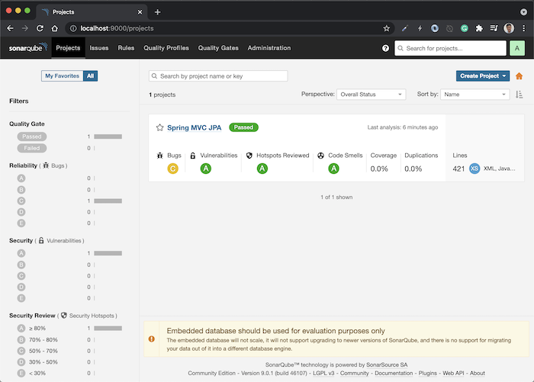
Sonarqube installation
# TO ISNTALL SONARQUBE USING DOCKER
docker run -d --name sonar -p 9000:9000 sonarqube:lts-community
docker ps
publicip:9000

Slide 8
maven
Maven is a build automation tool used primarily for Java projects.
Maven can also be used to build and manage projects written in C#, Ruby, Scala, and other languages.
addresses two aspects of building software: how software is built and its dependencies
Maven is built using a plugin-based architecture that allows it to make use of any application controllable through standard input
LIFECYCLE:
Validate ,compile ,test ,package ,install ,deploy, clean
Pom.xml: contains properties, plugins, dependencies and about app.
SPRING INITIALIZER: used to write a java project using maven

Slide 9
OWASP dependency check
It’s a security tool
Dependency-Check is a Software Composition Analysis (SCA) tool that attempts to detect publicly disclosed vulnerabilities contained within a project’s dependencies.
It does this by determining if there is a Common Platform Enumeration (CPE) identifier for a given dependency.
It identifies the third party libraries in a web application project and checks if these libraries are vulnerable using the NVD database.
The core engine contains a series of analyzers that inspect the project dependencies and identify the CPE for the given dependency. If a CPE is identified then it is cross referenced to the NIST CVE database and any associated Common Vulnerability and Exposure (CVE) entries are listed in the report.
Dependency-Check’s core analysis engine can be used as:
an Ant Task
a Command Line Tool
Gradle Plugin
Jenkins Plugin
Maven Plugin
SBT Plugin

Slide 10
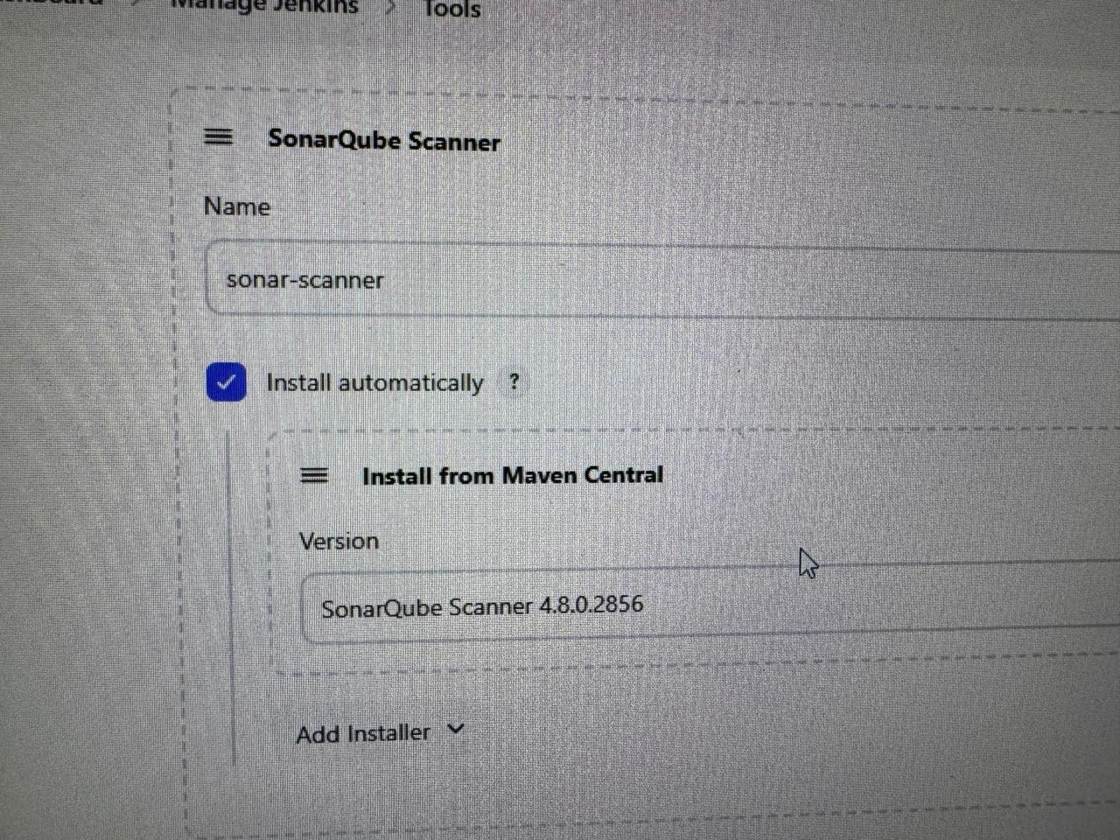
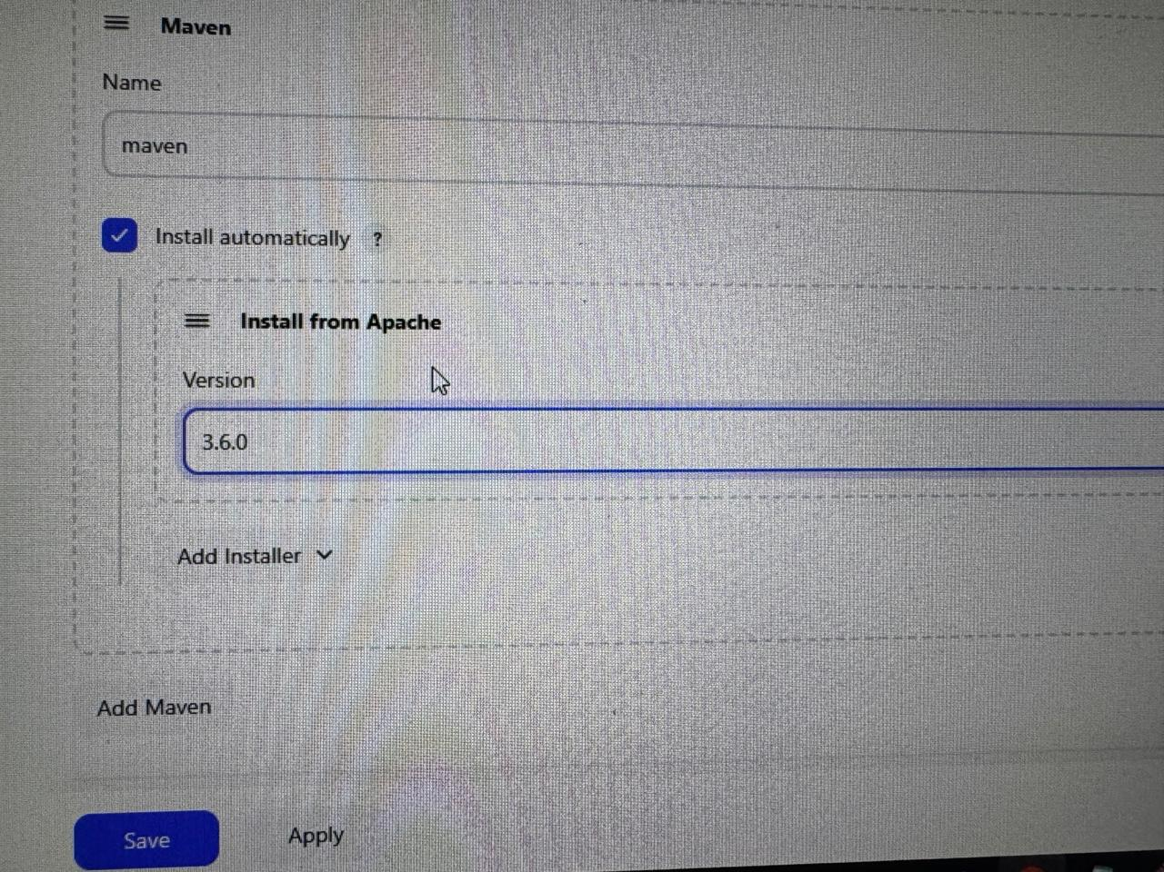
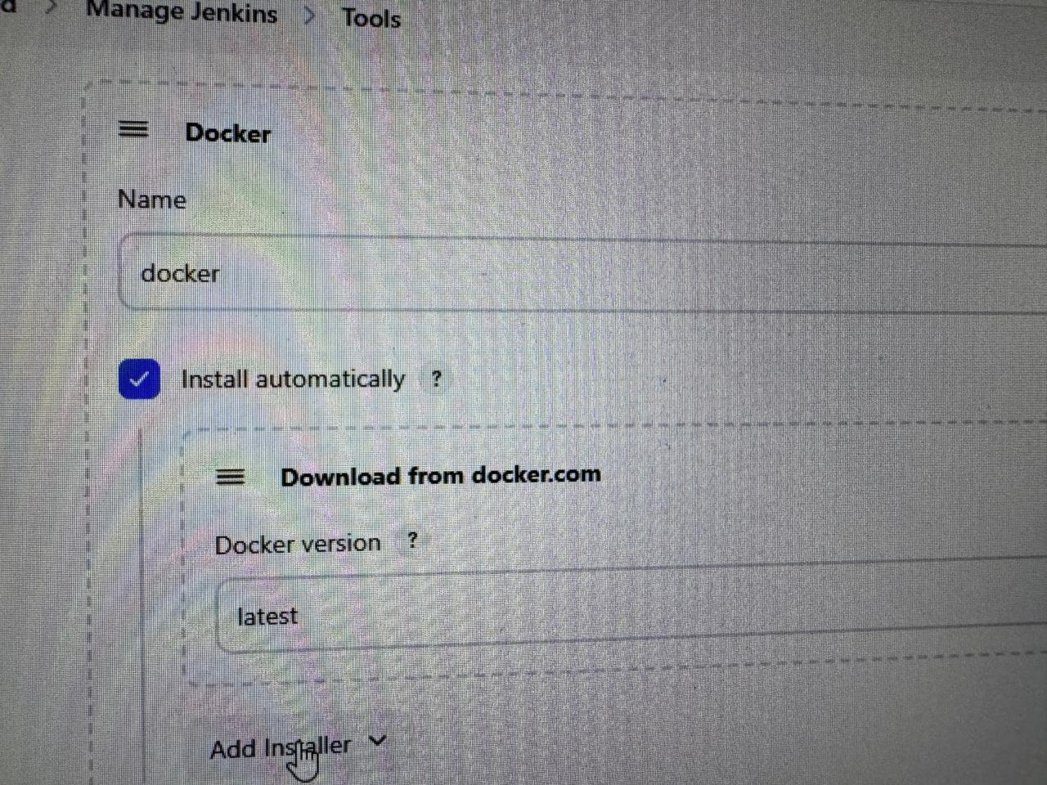
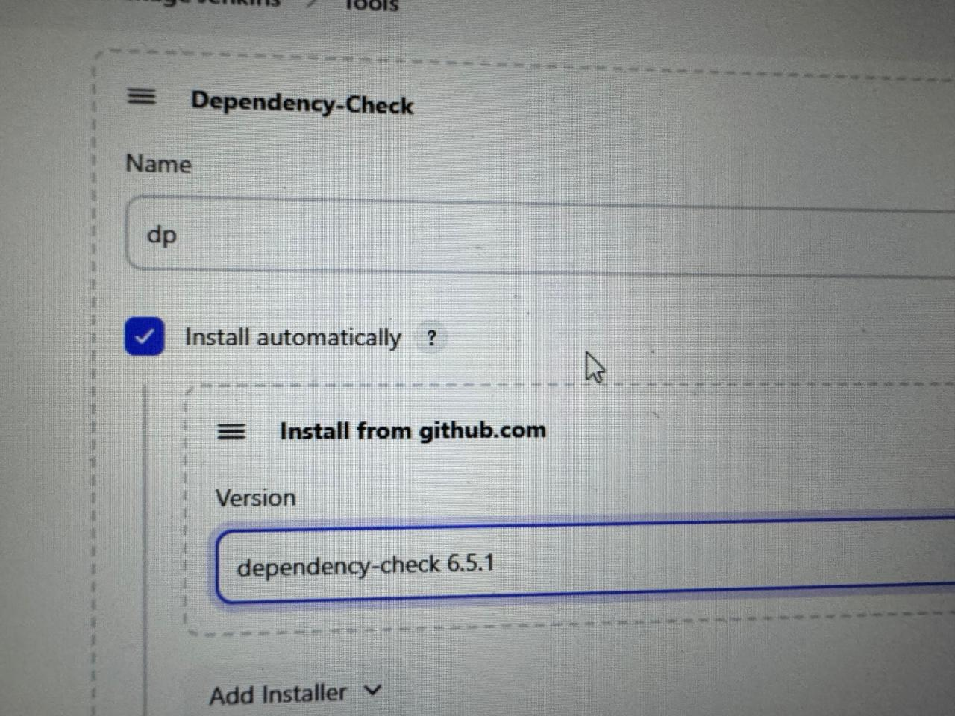
Plugins, configuration tools & script
plugins- eclipse termium installer, open jdk native plugin ,OWASP dependency check,
docker, docker pipeline, docker build step ,cloud bees, SonarQube scanner
CONFIGURE TOOLS IN GLOBAL TOOL CONFIGURATION

Slide 11
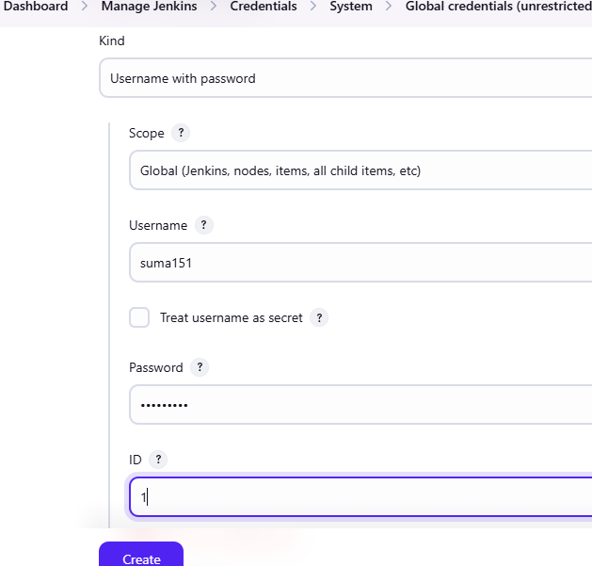
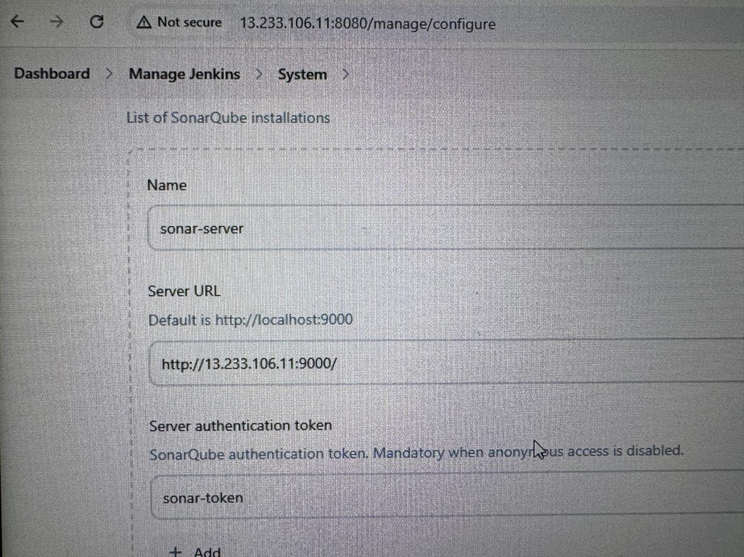
credentials
Credentials are needed in Jenkins pipelines to securely access external applications and sites that interact with Jenkins
Add SonarQube[server URL, token] and docker hub[Username, password] credentials as we are accessing external resources

Slide 12
Creating job in Jenkins
Create a new job as pipeline, add script to it ,script includes git as source code management, maven to build and compile code, SonarQube for code analysis ,OWASP dependency to detect publicly disclosed vulnerabilities contained within a project’s dependencies, Docker to build push that image to container.

Slide 13
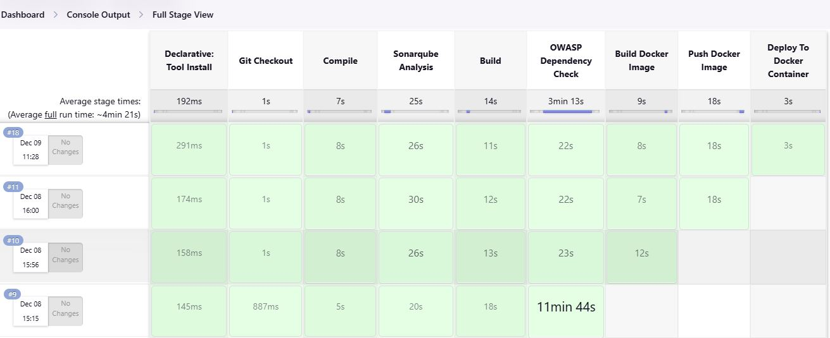
Build now

Slide 14
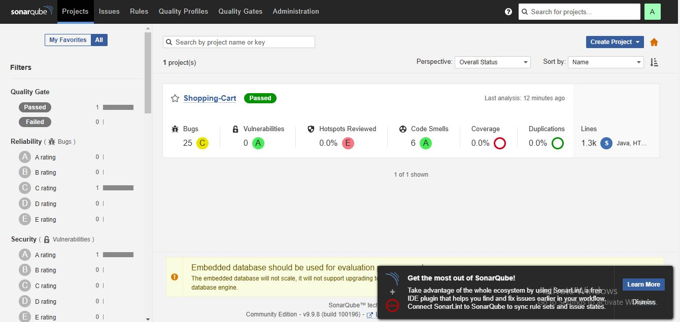
SonarQube analysis

Slide 15
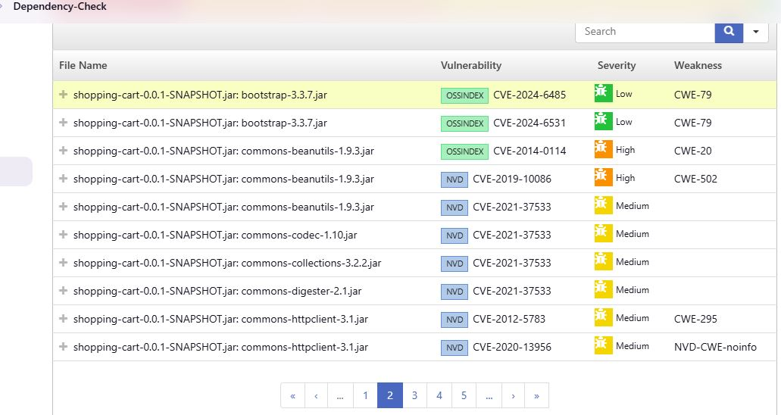
Dependency check

Slide 16
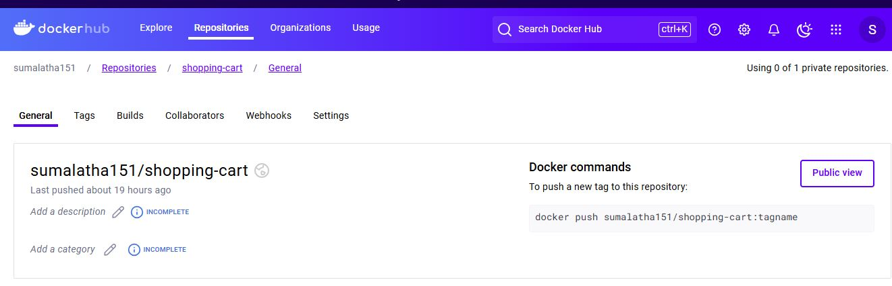
Docker hub

Slide 17
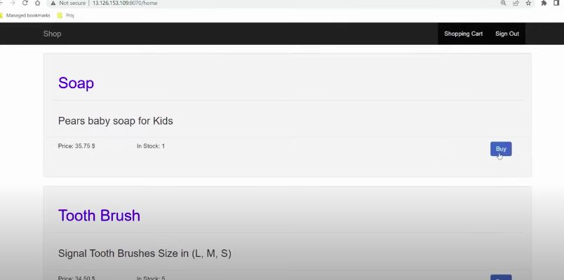
application
Access through publicip:8070

